Slide 1

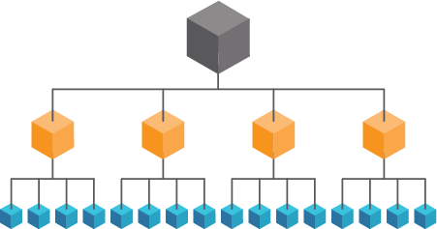
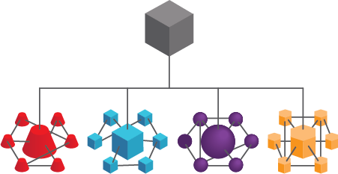
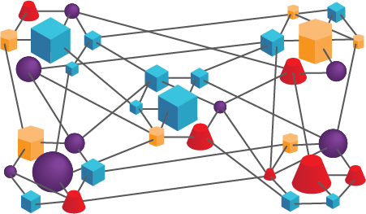

Autonomy - Self-Directed Teams for Exponential Growth!
Autonomy - Exponential Organizations (ExOs) harness the ExO attribute, Autonomy, to be more resilient, adaptive and scalable. In the increasingly dynamic and complex environments of the 21st century, these qualities often make the difference between success and extinction. Self-organizing, multi-disciplinary teams are formed. These teams have the authority and accountability to make decisions and choose how to accomplish their goals.
With the right frameworks, information and decisions travel more rapidly through the organization, speeding up the metabolism while eliminating the need for layers of hierarchy. Autonomy is also highly attractive to the innovative, self-directed individuals companies are courting. See also: Social, Dashboards, Interfaces.
Frameworks - Lean/Agile, OKRs, Holacracy.
Lean and Agile Frameworks such as Scrum methodology allow enough autonomy to the Scrum teams in how they get work done, in alignment with desired outcomes. Further, organizations can institute a ‘Team of Teams’ network based on distributed decision authority to accomplish goals of almost any size in highly-fluid and complex environments. For instance, in order to be effective against a distributed, adaptive network of insurgents in Iraq and Afghanistan, the US military moved from siloed command and control in favor of a Team of Teams approach.
Objectives and Key Results (OKRs) - This Shared Goals framework from Andy Grove at Intel is now practiced at Google, LinkedIn, Dropbox and others. Essentially, the company sets annual and quarterly goals. Teams and individuals then create their own OKRs, aligning with the company’s objective, but they do so all at once, in negotiation with each other.
Critical to a sense of autonomy is that more than half of company objectives originate from individual OKRs, bringing wisdom from the edges of the organization, inward. For example, what started as an Individual OKR from an engineer frustrated with the state of mail clients became Gmail, now one of Google’s core strategic products.
See also www.theokrguide.com
Holacracy involves a fundamental change in decision authority. A constitution defines decisions and governance of an organization. Roles are created around work, authority is distributed and everyone is bound to one set of rules. The purpose and values focus decisions and behavior. It is easier to integrate structures like holacracy in a startup than to change the structure of an existing organization. See also Reinventing Organizations by Frederic Laloux and Holacracy.org
Company Level Objectives
Lead to
Team Level Objectives
Lead to
Team Member Level Objectives
“Holacracy is a systemic change to a new power structure, and that’s a binary shift: either power is held and delegated by a manager, or it’s held by the Holacracy constitution.”
- Brian J. Robertson, author Holacracy: The New Management System for a Rapidly Changing World
Command
Command of Teams
Team of Teams
See also Scrum: The Art of Doing Twice the Work in Half the Time by Jeff Sutherland and JJ Sutherland, and Team of Teams: New Rules of Engagement for a Complex World, by Gen. Stanley McChrystal et.al.
Work licensed under Creative Commons Attribution-NoDerivatives 4.0 International License. By Growth Institute Inc. For a copy of this license, http://creativecommons.org/licenses/by-nd/4.0/ Rev 1.0 2018-07-03 TO LEARN HOW TO USE THIS TOOL, VISIT www.growthinstitute.com/exo

Slide 2


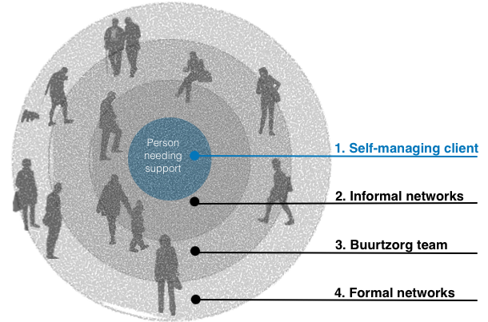

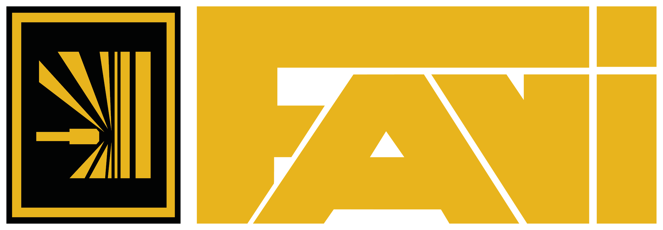


Autonomy - Examples and Tips for Getting Started
Buurtzorg is a pioneering health care organization in the Netherlands with 9,000 nurses and only 28 support staff. It is a distributed network of nurse teams of 10-12 with local decision authority, caring for people in their neighborhoods. They save the Dutch social security system hundreds of millions of Euros each year, and actively help competitors learn their methods and philosophy.
ING - an international bank with over 50,000 employees across 40 countries serving 37 million customers, implemented an Agile model at their headquarters in 2015.
Read this article from McKinsey Quarterly, here: www.mckinsey.com/industries/financial-services/our-insights/ings-agile-transformation
Tribe
Squad
Squad
Squad
Squad
Tribe
lead
Agile
coach
Chapter
FAVI - since 1983 this 400-person French automotive parts supplier has operated in teams with no management layer or executive committee. It commands 50%
market share, it hasn’t missed a shipping date in over 25 years, and with profit-sharing, each employee receives 16-17 months salary equivalent per year.
Read more in Reinventing Organizations by Frederic Laloux
Zappos - with 1500 people, is the largest holacracy- powered organization to-date.
Read more here: www.zapposinsights.com/about/holacracy
Valve - a privately-held 300-person game software and distribution platform company with no classic management structure. Cofounder and CEO, Gabe Newell owns a bit over 50% of Valve, and had a net worth of $5.5 bn in 2018, according to Forbes. Read their 2012 Employee Handbook, here: www.valvesoftware.com/company/Valve_Handbook_LowRes.pdf
Chapter
P
Product
owner
P
P
P
P
Chapter
lead
Source: www.mckinsey.com/industries/financial-services/our-insights/ings-agile-transformation
Where to Begin:
Start by creating and socializing your Massive Transformative Purpose (MTP). Your company’s North Star, it guides you to your future, and helps your people align outcomes.
Use your company’s Core Values as the guardrails for behavior and decisions. We recommend Jim Collins’ articles, exercises and book, Built to Last, Chapter 3 - Core Values.
Hire to match your structure and culture. Self-directed self- starters and entrepreneurs aligned with your values will thrive.
Create and empower small, independent, multidisciplinary teams (Zappos and ING both started with a pilot project). When they are oriented, push decision-making to the edges, closest to the customer.
Create Dashboards to provide open, transparent access to needed metrics
Well-executed autonomy will require additional ExO attributes: MTP, Engagement, Social, Dashboards, Experimentation.
Work licensed under Creative Commons Attribution-NoDerivatives 4.0 International License. By Growth Institute Inc. For a copy of this license, http://creativecommons.org/licenses/by-nd/4.0/ Rev 1.0 2018-07-03 TO LEARN HOW TO USE THIS TOOL, VISIT www.growthinstitute.com/exo

Slide 3
Getting Started - First Experiments in Autonomy
To prepare for your first 1-3 small experiments, answer the following...
Why are you focused on Autonomy, now? You may be a startup, and Autonomy is core to you, or you may be facing issues you suspect stem back to centralized decision-making and control as a limiting factor. Briefly note what’s going on - what’s driving your exploration.
What is the outcome you want for this experiment? Want to learn about a framework? Stimulate innovation? Reduce time-to-market? Retain talent? Briefly note your objectives.
Does your MTP provide enough direction that people organize and align around it today? Give an example you witnessed recently. If your current MTP does not, or if you haven’t created your MTP yet, see Where to Begin, page 2.
Do your organization’s Core Values offer clear guide rails for what people should and shouldn’t do? Give an example you witnessed recently. If you are unsure your people believe and own the values, invest the time to clarify them. See Where to Begin, page 2.
Now, Download and use the ExO Experimentation Tool: blog.growthinstitute.com/exo/experimentation
Who is your customer? Who are you doing this experiment for? Who will be most impacted by the outcome of your experiment? Involve them in the experiments!
What is your hypothesis (assumption)? e.g. We believe that... “Our new business model requires distributed decision-making or we won’t be able to scale.” or “Customer Service scores are declining because issue resolution currently requires many layers of approvals.” etc.
Start with the simplest framework that will support your early experiments... OKRs is probably the easiest, quickest framework to experiment with. Start small - a team of individuals aligning with company OKRs. Maybe graduate to scrumming a special project, recruiting a seasoned Scrummaster to guide a Product Owner and Delivery Team. To move fast and keep costs down, use Staff-on-Demand to source subject matter experts.
Do your homework before more ambitious experiments. Some of these methodologies, holacracy in particular, require radical shifts in power structure and culture. Study these methods and borrow ideas for your experiments.
OKRs (i.e. Google)
Agile/Scrum/Kanban for specific projects and functions (Product Development, Continuous Improvement, etc.)
Agile/Scrum/ Team of Teams for running an organization (i.e. ING BANK; US Military)
Reinventing Organizations - Teal Organizations (i.e. FAVI)
Holacracy (i.e. Zappos, Valve)
And many others...
*See Chapter 4 - Inside the Exponential Organization in Exponential Organizations by Salim Ismail, Michael S. Malone & Yuri van Geest. The Exponential Organizations Master Business Course is a part of the Growth Institute MBD Program. To learn more, visit www.growthinstitute.com/exo
Share this tool - info.growthinstitute.com/autonomy-tool
Work licensed under Creative Commons Attribution-NoDerivatives 4.0 International License. By Growth Institute Inc. For a copy of this license, http://creativecommons.org/licenses/by-nd/4.0/ Rev 1.0 2018-07-03 TO LEARN HOW TO USE THIS TOOL, VISIT www.growthinstitute.com/exo

